Slide 1
PCA & Factor Analysis Highlights
Melvin Ott, PhD

Slide 2
PCA Intro
Find a set of uncorrelated variables, each of which is a linear combination of the original variables that will describe the variation in the response variable.
The uncorrelated variables are derived so that the first explains the most variability, followed by the second, etc.
The first principal component is that linear combination whose sample variance is greatest among all possible linear combinations

Slide 3
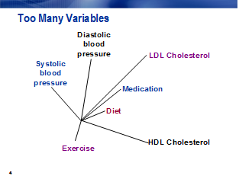
Example

Slide 4
PCA
Eliminate some redundant variables.
May lose important information that was uniquely reflected in the eliminated variables.
Create composite scores from variables (sum or average).
Lost variability among the variables
Multiple scale scores may still be collinear.
Create weighted linear combinations of variables while retaining most of the variability in the data.
Fewer variables; little or no lost variation
No collinear scales.

Slide 5
More PCA
How Many Components?
Explain between 70-90% of the original variables variation
Exclude principal components whose eigenvalue is less than the average
Look for elbow in scree diagram, this is where large eigenvalues end and small eigenvalues begin

Slide 6
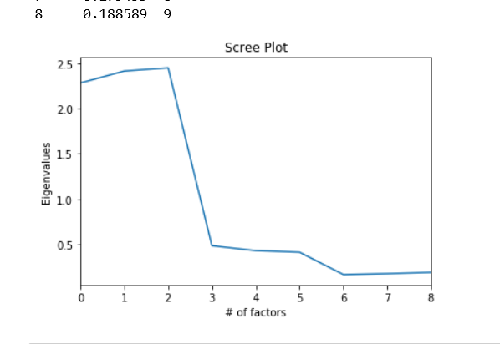
Example Scree Plot

Slide 7
Why Factor Analysis?
You suspect that the variables you observe (manifest variables) are functions of variables that you cannot observe directly (latent variables).
Identify the latent variables to learn something interesting about the behavior of your population.
Identify relationships between different latent variables.
Show that a small number of latent variables underlies the process or behavior you have measured to simplify your theory.
Explain inter-correlations among observed variables.

Slide 8
Factor Analysis
Focus is on Variables in the Analysis
Look at Correlations among Variables
Group Variables into Factors
Exploratory or Confirmatory
Exploratory means whatever the data suggests
Confirmatory means use prior research or some theory

Slide 9
Example
Health Care
Principal Components would be the Symptoms
Latent Factors would be the Disease

Slide 10
Assumptions
The unique factors (residuals) are uncorrelated with each other.
The unique factors (residuals) are uncorrelated with the common (latent) factors.

Slide 11
PCA vs Factor Analysis
PCA
100% of variance accounted for by all components.
The components are derived from the variables and explain 100% of the variation in the data.
Factor Analysis
Not necessary that 100% of variance be accounted for by the extracted factors.
The variables reflect the common (latent) factors and explain shared variation in the manifest variables.

Slide 12
Limitations for Factor Analysis
Factor scores are not linear combinations of the variables. They are estimates of latent factors. Avoid problems by:
1. Carefully selecting your manifest variables.
2. Using rotation to interpret the factors.
3. Performing a confirmatory factor analysis to test hypotheses about the adequacy of the factor solution.

Slide 13
Methods
Principal Factor Analysis
Computationally efficient
Most commonly used.
Maximum Likelihood Factor Analysis
Less efficient computationally; iterative procedure
Better estimates than principal factor analysis in large samples
Hypothesis tests for number of factors.

Slide 14
How Many Factors?
Kaiser Criterion
Eigenvalues greater than one in the unrotated principal components solution
Scree test
Find the elbow

Slide 15
Rotations
Varimax-Orthogonal: Maximizes the variance of columns of the factor pattern matrix.
Promax-Oblique in two steps.

